Slide 1
Employee Data Analysis using Excel
STUDENT NAME: RAMYA R
REGISTER NO:312205105
DEPARTMENT: B.com (General)
COLLEGE: NAZARETH COLLEGE OF ARTS AND SCIENCE

Slide 2
PROJECT TITLE
Employee Performance Analysis using Excel

Slide 3


AGENDA
Problem Statement
Project Overview
End Users
Our Solution and Proposition
Dataset Description
Modelling Approach
Results and Discussion
Conclusion
3/21/2024 Annual Review

Slide 4

PROBLEM STATEMENT
Employee performance analysis is a key method for understanding each team member’s strengths and areas for improvement. It enables managers to identify where additional support or development is needed, leading to increased productivity when resources and training are directed toward these specific areas. This process fosters transparency and accountability by setting clear expectations. Furthermore, targeted feedback and training not only aid in employee development but also enhance job satisfaction and retention. By aligning individual goals with organizational objectives, performance analysis ensures that all efforts contribute to the company’s overall success, creating a motivated and cohesive team.

Slide 5

PROJECT OVERVIEW
This project will analyze employee performance data across several key factors, including Business Unit, Employee Status, Employee Type, Performance Score, and Current Employee Rating. The goal is to identify strengths and areas of concern, ultimately providing recommendations for strategies to enhance performance and support employee development within the organization.
.

Slide 6

WHO ARE THE END USERS?
Managers: Utilize performance analysis to guide decisions on training and development. HR Professionals: Use the data to inform recruitment, retention, and promotion strategies. Executives: Rely on performance insights to align individual contributions with organizational goals. Employees: Benefit from targeted feedback and development opportunities based on their performance. Team Leaders: Leverage analysis to optimize team dynamics and improve overall productivity.

Slide 7
OUR SOLUTION AND ITS VALUE PROPOSITION
Conditional Formatting: Highlight missing values in the data to quickly identify gaps that need attention. Filter: Use filters to focus on or exclude rows with missing values, simplifying data cleaning and ensuring efficient analysis based on complete records. Formula: Apply various formulas to accurately compute performance metrics, aiding in effectively quantifying employee performance. Pivot Table: Create pivot tables to summarize data by categories such as department or time period, revealing hidden patterns or trends. Graphs: Utilize graphs to visually compare and analyze performance metrics across different groups or time periods.

Slide 8
Dataset Description
Employee dataset : Collected from edunet foundation
Features : there are 26 features
Main features are,
Employee id : unique identify number for employee
Name : employee’s first and last name in letters
Employee type : it identifies whether they are part time or contract or full time employer
Employee department : it identifies the department
Gender : it is considered as male and female
Employee rating : rating are in numeric value
`

Slide 9

THE "WOW" IN OUR SOLUTION
Calculated the Performance level using the formula
IFS(Z8>5,”VERYHIGH”,Z8>=4,”HIGH”,Z8>=3,”MED”,TRUE,”LOW”)
3/21/2024 Annual Review
9

Slide 10
MODELING
Data Sources:
Performance ratings are differentiated by employee type - Contract, Full-Time, Part-Time - and levels - HIGH, MEDIUM, LOW, VERY HIGH - business-unit-wise.
Tools Used:
1. Pivot Table: Provides the count of employees in each performance category by business unit, filtered by employee type.
2. Slicers: Allows dynamic filtering of data by employee type for focused analysis.
3. Graph: Presents the distribution of performance levels across business units and hence makes data comparison and interpretation easier.
10

Slide 11
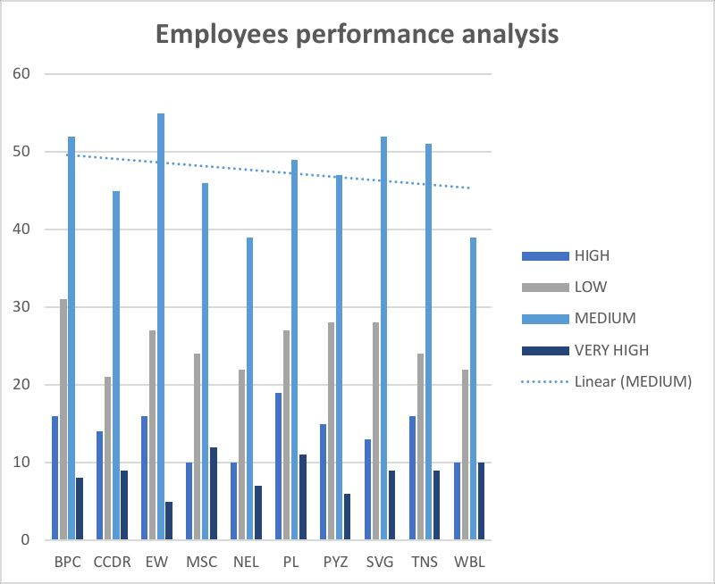
RESULTS
11

Slide 12
conclusion
1. Medium Performers: The majority of all employees in all business units perform at a "Medium" level, reflecting consistency in performance across the organization.
2. Poor performers: Divisions like BPC and CCDR have a greater share of employees highlighted as low performers.
3. High and Very High Achievers: Business units like EW and PL have higher representations of "High" and "Very High" achievers, reflecting improved performance in those areas.
4. Areas of Improvement: Every unit with more low performers would need targeted interventions, while units with fewer top performers might need to develop strategies that increase high-level performance.

